Slide 1
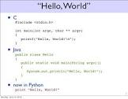


Hello World
For **Python** and **Java**
Created with a trial version of Syncfusion Essential Presentation

